Slide 1
RELATIONAL DATABASE SERVICE
PRESENTED BY: CHIDUBEM CHINWUBA

Slide 2
ARCHITECTURE

Slide 3
OUTLINE
INTRODUCTION
CREATE AN RDS DATABASE
CONNECT TO SQL ELECTRON
UPDATE RDS TABLE

Slide 4
INTRODUCTION
RDS is a managed service:
Automated provisioning, OS patching
Continuous backups and restore to specific timestamp (Point in Time Restore)!
Monitoring dashboards
Read replicas for improved read performance
Multi AZ setup for DR (Disaster Recovery)
Maintenance windows for upgrades
Scaling capability (vertical and horizontal)
Storage backed by EBS (gp2 or io1)
BUT you can’t SSH into your instance

Slide 5
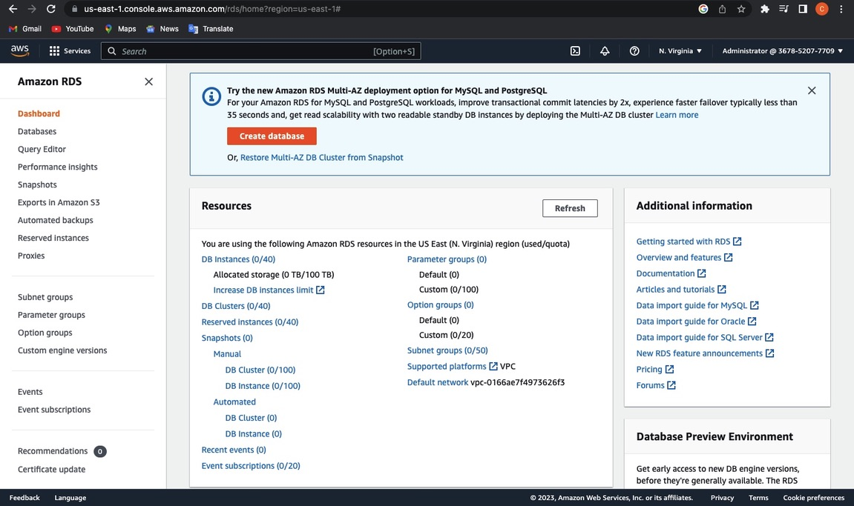
CREATE AN RDS DATABASE

Slide 6
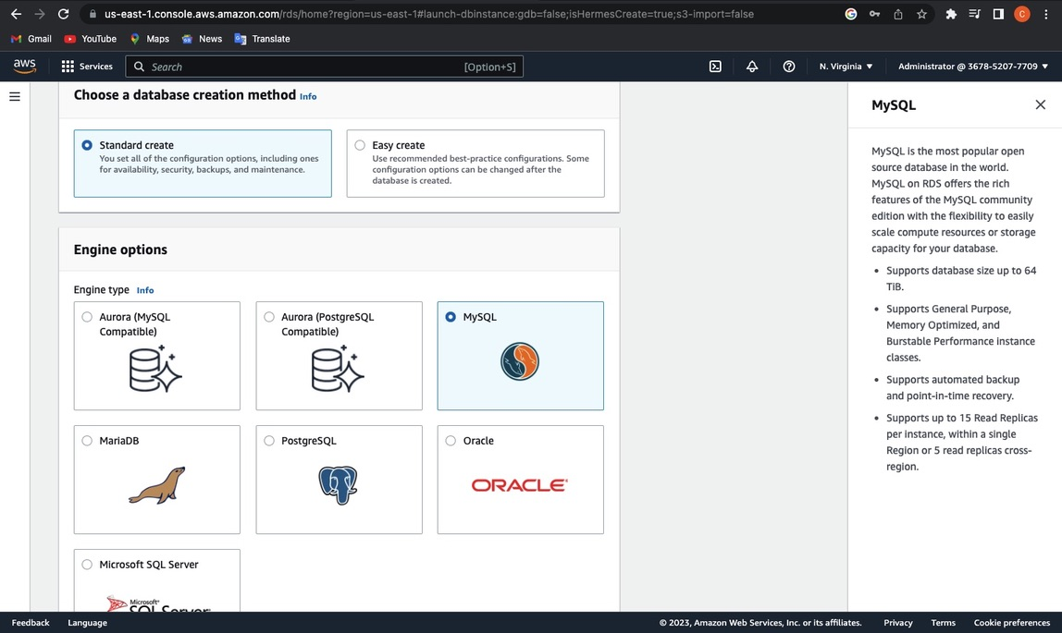

Slide 7
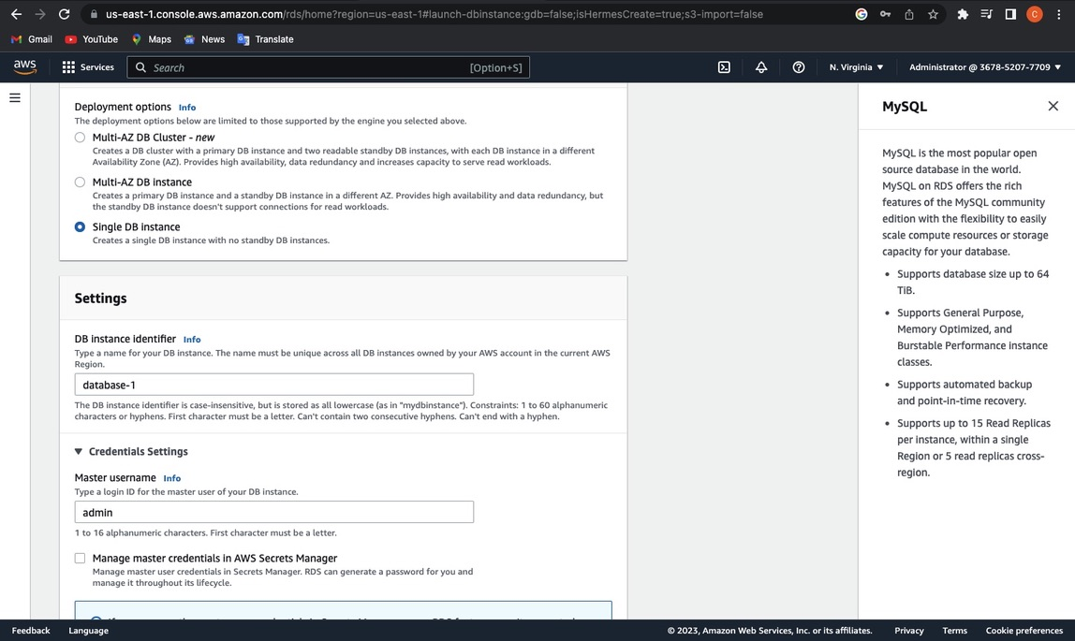

Slide 8
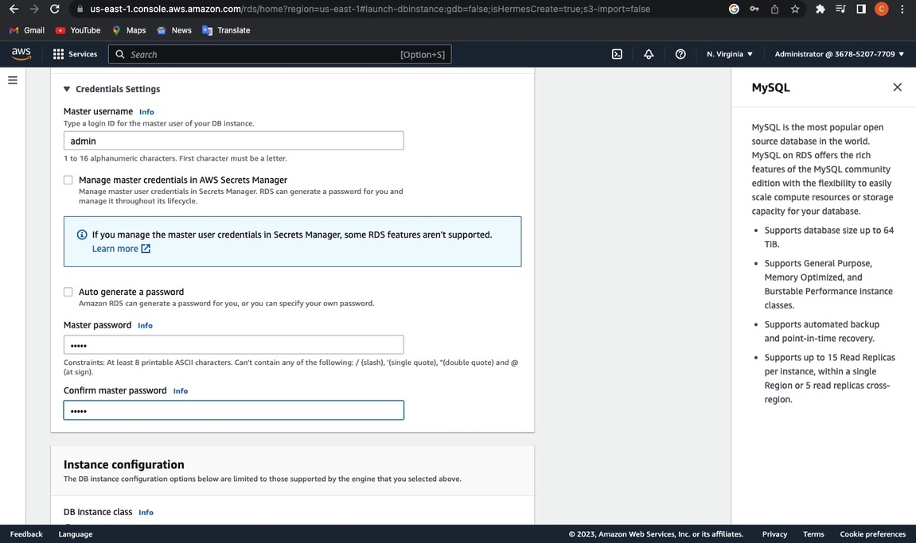

Slide 9
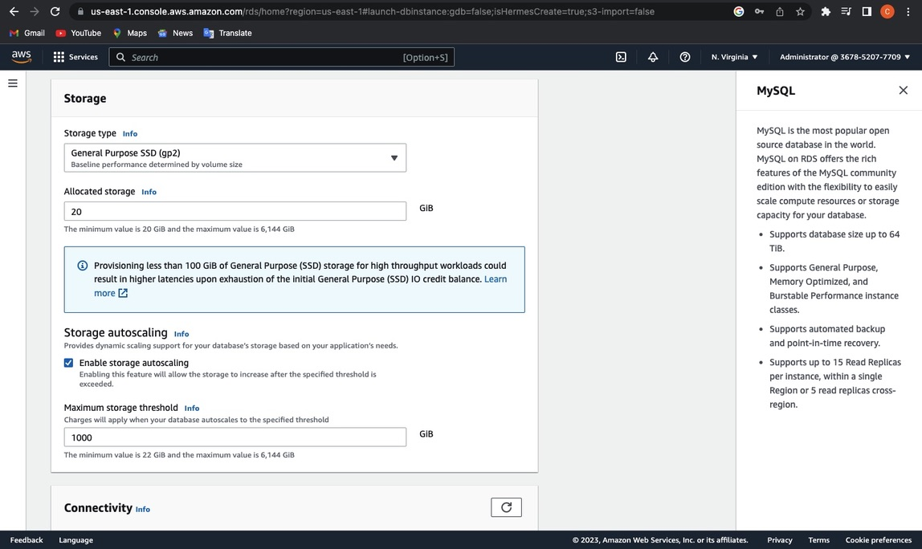

Slide 10
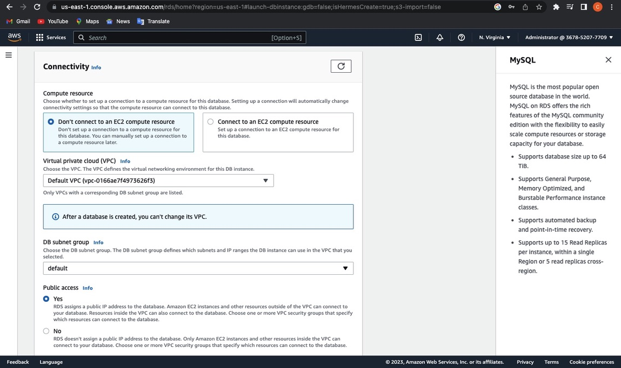

Slide 11
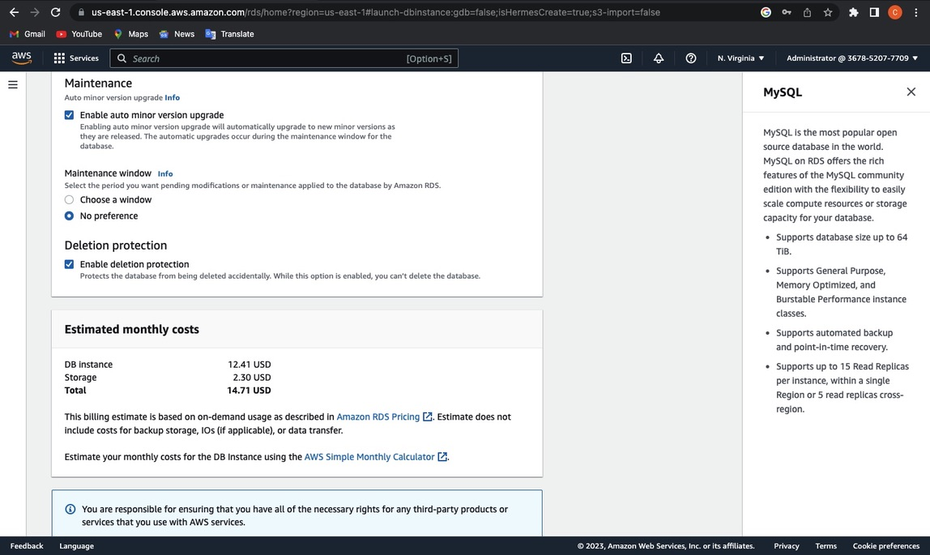

Slide 12
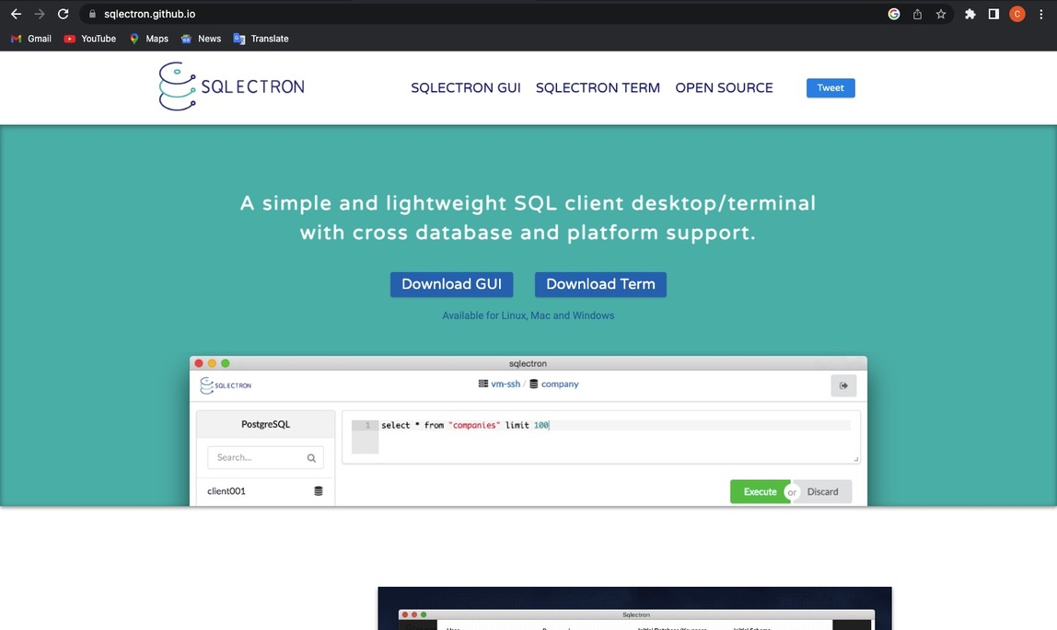
CONNECT TO SQL ELECTRON

Slide 13
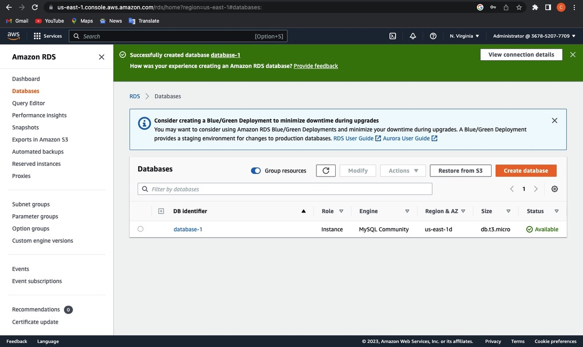

Slide 14
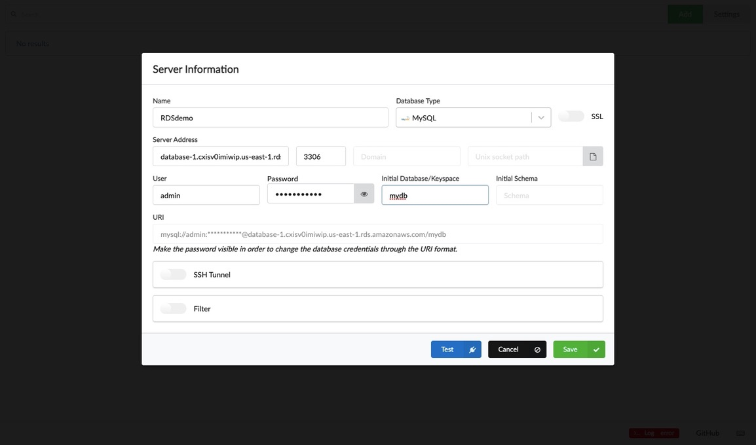

Slide 15
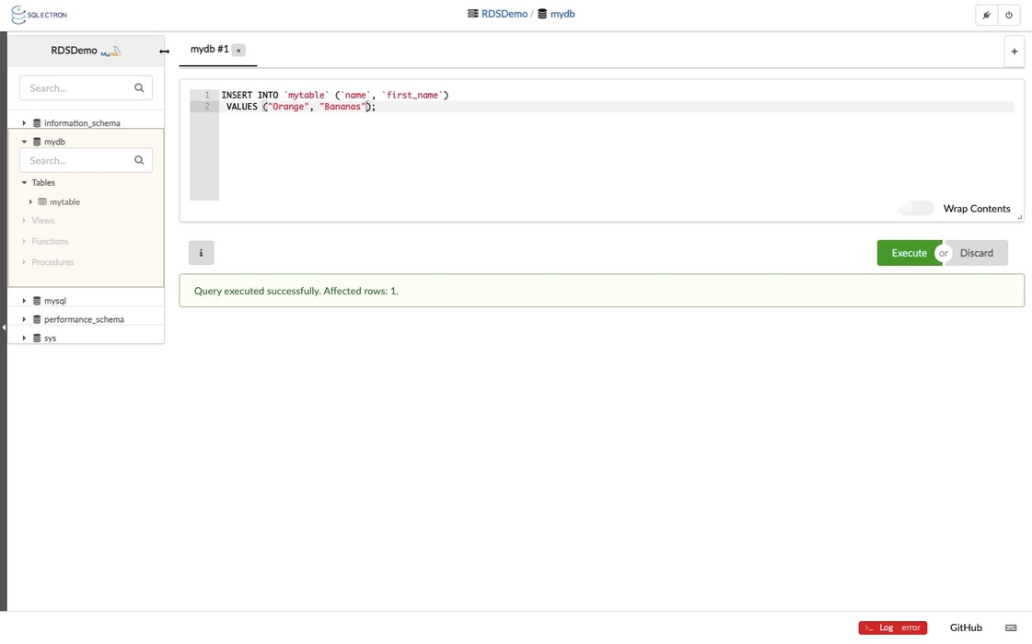

Slide 16
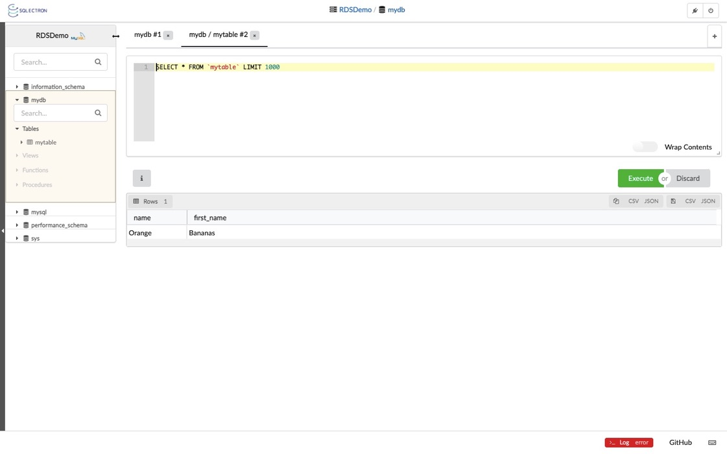

Slide 17
